Slide 1


Social Startup Project
PROJECT NAME :
Presented by [Your Name Here]

Slide 2
Introduction / تقديم
Presente votre projet

Slide 3

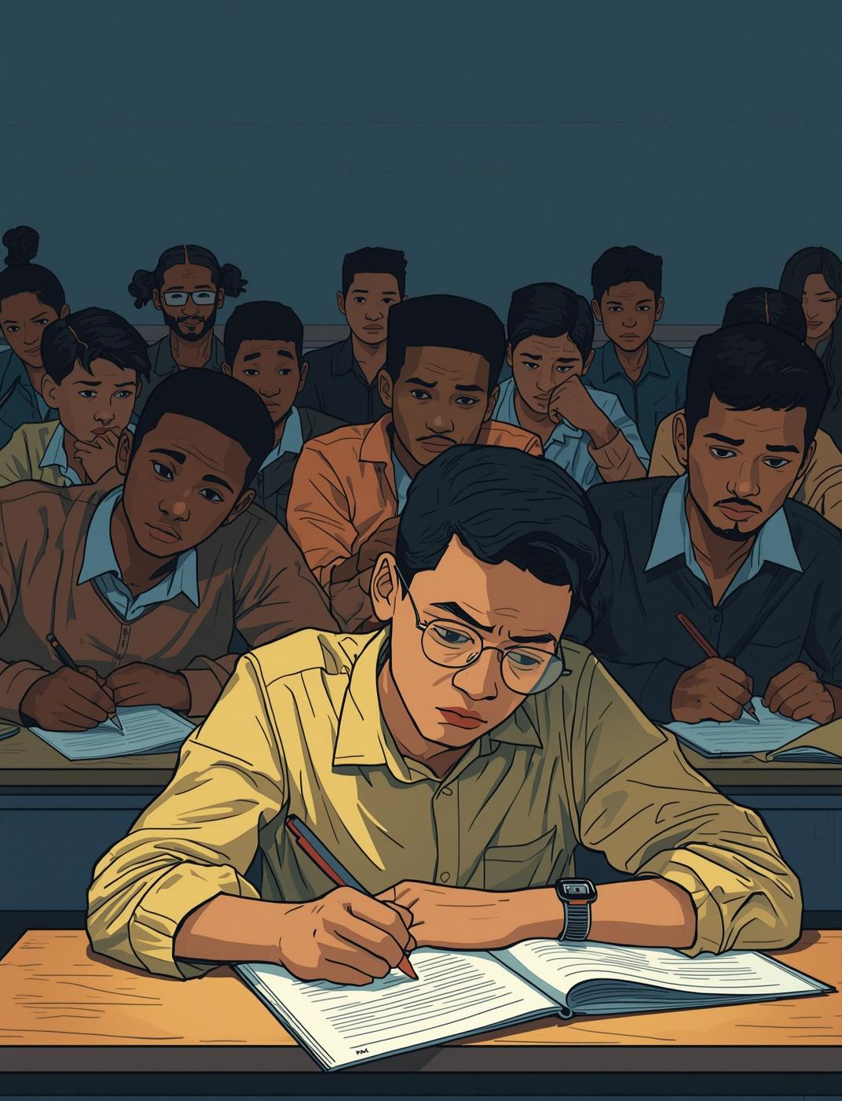
The Problem /
Understanding the Issue / فهم المشكلة
Many students face significant barriers in accessing essential resources, leading to educational disparities and negative impacts on their learning experiences and future opportunities.

Slide 4
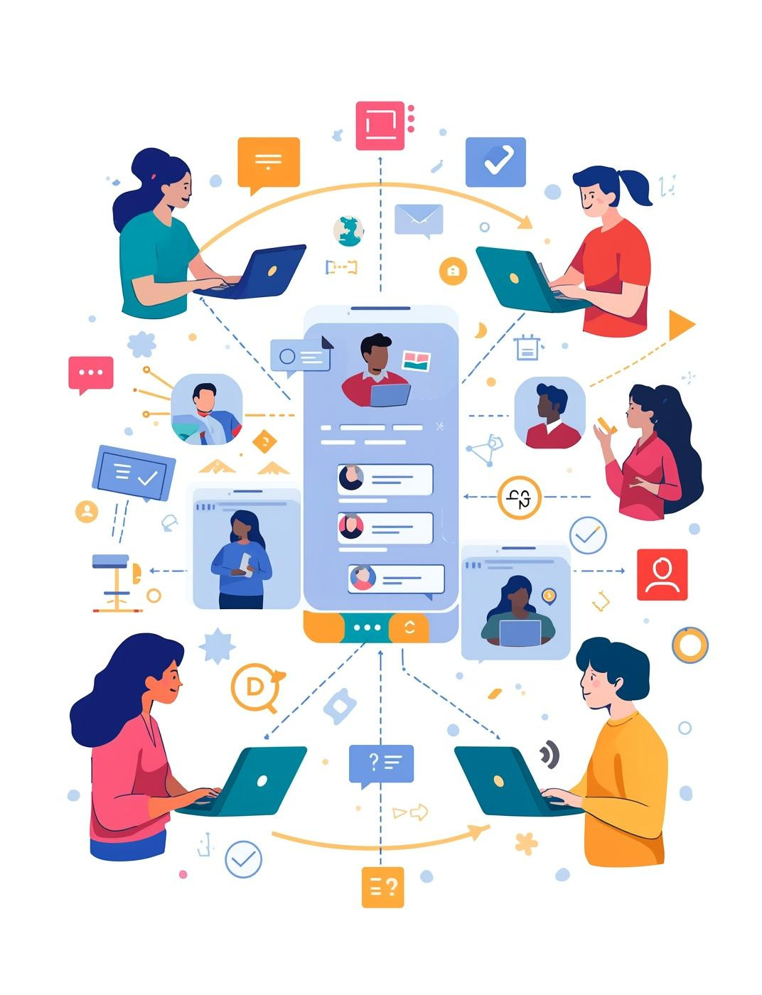
The Solution /الحل المقترح
Our Innovative Approach / نهجنا المبتكر
Our project offers a unique solution to connect students, teachers, and parents, enhancing communication and collaboration for better educational outcomes within our community.

Slide 5


Social Impact / الأثر الإجتماعي
Positive Changes We Create / التغييرات الإيجابية التي نحدثها
Empowering Youth /تمكين الشباب
Community Engagement / مشاركة المجتمع
Our project focuses on empowering young people by providing them with the tools and resources needed to make a difference in their communities, fostering leadership and innovation.
We aim to engage the community actively by involving local stakeholders and encouraging participation, which helps build a sense of ownership and pride in the project’s outcomes.

Slide 6

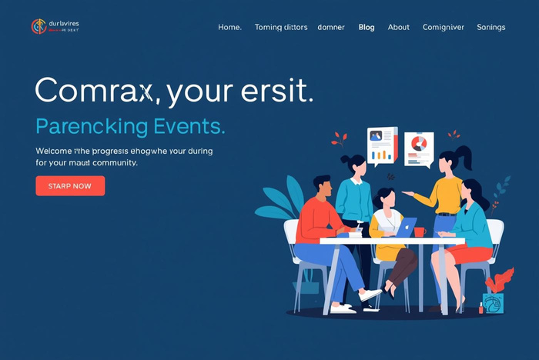


Target Audience /الفئة المستهدفة
Students
Parents
Our project directly benefits students by providing resources.
The initiative enables parents to stay informed about education.
Teachers
Schools
Educators gain tools to enhance their teaching effectiveness.
The project fosters an improved educational environment for all.

Slide 7
Implementation Plan / خطة التنفيذ
Planning
Testing
Launch
Initial project planning and team organization to establish roles and responsibilities.
Conducting trial runs to refine processes and gather feedback for improvements.
Official project launch, promoting the initiative to the target audience and community.

Slide 8




Resources Needed /الموارد المطلوبة
Team & Mentors
Financial Support
الدعم من الأفراد ذوي الخبرة يساعد في توجيه مشروعنا.
التمويل ضروري لتنفيذ مشروعنا بفعالية.
Materials & Tools
Partnerships
نحن بحاجة إلى موارد مثل الإمدادات والتكنولوجيا للنجاح.
التعاون مع المنظمات المحلية يوسع تأثيرنا ومدى وصولنا.

Slide 9


Challenges & Risks / التحديات والمخاطر
Lack of Resources /• نقص التمويل المستمر
Community Engagement /مشاركة المجتمع

Slide 10

Business Module
Ecrir Ici

Slide 11
“We believe that youth can lead the change. Together, we build a better future.”
نحن نؤمن بأن الشباب قادرون على قيادة التغيير. معًا، نبني مستقبلاً أفضل.
Team Vision

Slide 12
Thank You for Your Attention
شكراً لاهتمامكم

